Slide 1
Chapter 10 Emerging Trend in Databases
10.1 NoSQL Databases
10.2 Object Oriented Database and ORM
10.3 Distributed Databases
10.4 Distributed Ledged Technology: Blockchain,
Cryptocurrency, Blockchain Properties

Slide 2
10.1 NoSQL Databases
NoSQL is a type of database management system (DBMS) that is designed to handle and store large volumes of unstructured and semi-structured data.
Unlike traditional relational databases that use tables with pre-defined schemas to store data,
NoSQL databases use flexible data models that can adapt to changes in data structures and are capable of scaling horizontally to handle growing amounts of data.

Slide 3
10.1 NoSQL Databases
The term NoSQL originally referred to “non-SQL” or “non-relational” databases, but the term has since evolved to mean “not only SQL,” as NoSQL databases have expanded to include a wide range of different database architectures and data models.
NoSQL relies upon a softer model known as the BASE model. BASE (Basically Available, Soft state, Eventual consistency).
  Basically Available: Guarantees the availability of the data . There will be a response to any request (can be failure too).
  Soft state: The state of the system could change over time.
  Eventual consistency: The system will eventually become consistent once it stops receiving input.

Slide 4
10.1 NoSQL Databases
Features/Characteristics
Distributed computing system.
Higher Scalability.
Reduced Costs.
Flexible schema design.
Process unstructured and semi-structured data.
No complex relationship.
Open-sourced.
  Explain in brief about each (Assignment)

Slide 5
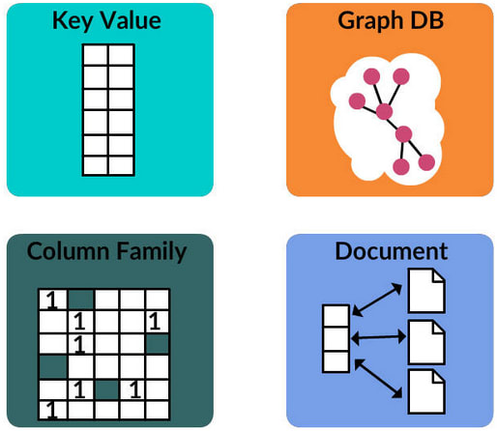
10.1 NoSQL Databases
Types(Categories) of NoSQL databases

Slide 6
10.1 NoSQL Databases
Types(Categories) of NoSQL databases
1. Key-Value Store Database:
Termed to be the simplest form of NoSQL database of all other types, the key-value database is a database that stores data in a schema-less manner. This type of database stores data in the key-value format.
Herein, a data point is categorized as a key to which a value (another data point) is allotted. For instance, a key data point can be termed as 'age' while the value data point can be termed as '45'.

Slide 7
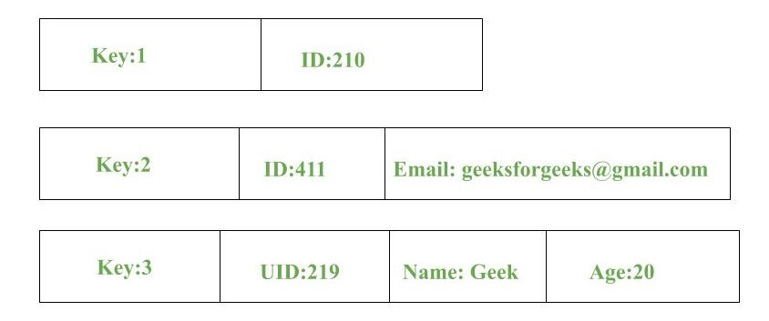
10.1 NoSQL Databases
Types(Categories) of NoSQL databases
1. Key-Value Store Database:

Slide 8
10.1 NoSQL Databases
Types(Categories) of NoSQL databases
1. Key-Value Store Database:
Features
Scalability: Large amounts of data and users.
Speed: Large number of queries.
Data model: Key-value pairs.
Consistency.
Transactions.
Querying ability.

Slide 9
10.1 NoSQL Databases
Types(Categories) of NoSQL databases
1. Key-Value Store Database:
Limitations
No relationships among Multiple-Data.
Multi-operation Transactions: If you are storing many keys and there is a failure to save one of the keys, you can’t roll back the rest of the operations.
Query Data by 'value': Searching the 'keys' based on some info found in the 'value' part of the key-value pairs.
Operation by groups: As operations are confined to one key at a time, there exists no way to run several keys simultaneously.

Slide 10
10.1 NoSQL Databases
Types(Categories) of NoSQL databases
1. Key-Value Store Database:
Real life examples
Key-Value would be best-fit to store user profile:
  userId, username.
additional attributes/preferences:
  Language
  Country
  Timezone
  User favorites
  and so on

Slide 11
10.1 NoSQL Databases
Types(Categories) of NoSQL databases
1. Key-Value Store Database:
DynamoDB
Riak
Berkeley DB
Redis

Slide 12
10.1 NoSQL Databases
Types(Categories) of NoSQL databases
2. Column Store Database:
Another type of NoSQL database is the column-oriented database. This type of database stores data in the form of columns that segregates information into homogenous categories.
This allows the user to access only the desired data without having to retrieve unnecessary information.
When it comes to data analytics in social media networking sites, the column-oriented database works very efficiently by showcasing data that is prevalent in the search results.

Slide 13
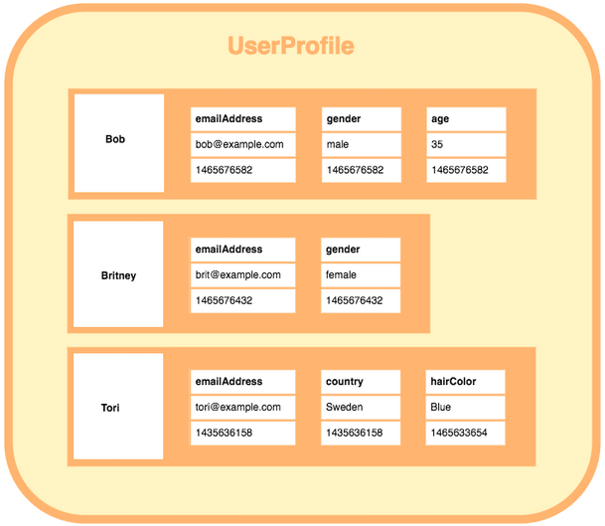
10.1 NoSQL Databases
Types(Categories) of NoSQL databases
2. Column Store Database:

Slide 14
10.1 NoSQL Databases
Types(Categories) of NoSQL databases
2. Column Store Database:
Features
Compression: Column stores are very efficient at data compression and/or partitioning.
Aggregation queries: Due to their structure, columnar databases perform particularly well with aggregation queries (such as SUM, COUNT, AVG, etc).
Scalability: Columnar databases are very scalable. They are well suited to massively parallel processing, which involves having data spread across a large cluster of machines – often thousands of machines.
Fast to load and query: Columnar stores can be loaded extremely fast. A billion row table could be loaded within a few seconds.

Slide 15
10.1 NoSQL Databases
Types(Categories) of NoSQL databases
2. Column Store Database:
Limitations
Incremental data loading: It takes more time writing data than reading. Online Transaction Processing (OLTP) usage.
Queries against only a few rows: Reading specific data takes more time than intended.

Slide 16
10.1 NoSQL Databases
Types(Categories) of NoSQL databases
2. Column Store Database:
Real life examples
A column family for vegetables of a supermarket.
A column family for clients.
A column family for users.

Slide 17
10.1 NoSQL Databases
Types(Categories) of NoSQL databases
2. Column Store Database:
Cassandra
HBase
Kudu

Slide 18
10.1 NoSQL Databases
Types(Categories) of NoSQL databases
3. Document Database:
The document database fetches and accumulates data in form of key-value pairs but here, the values are called as Documents.
Document can be stated as a complex data structure. Document here can be a form of text, arrays, strings, JSON, XML or any such format.
The use of nested documents is also very common. It is very effective as most of the data created is usually in form of JSONs and is unstructured.

Slide 19
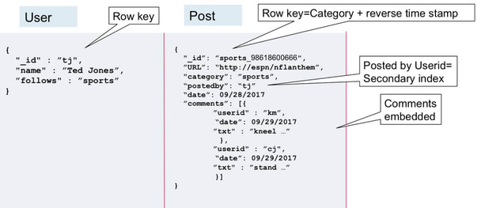
10.1 NoSQL Databases
Types(Categories) of NoSQL databases
3. Document Database:
JSON Databases

Slide 20
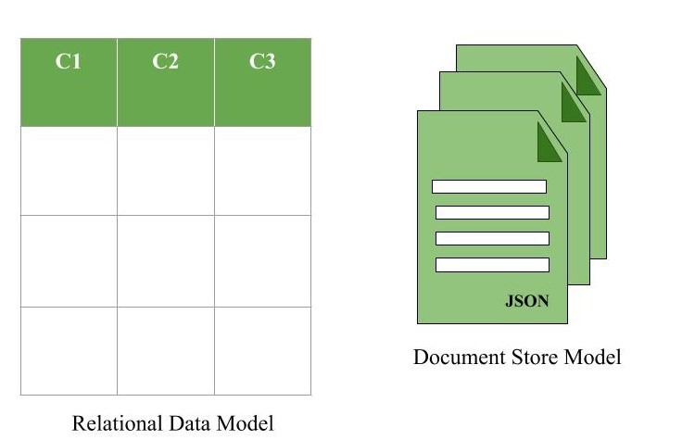
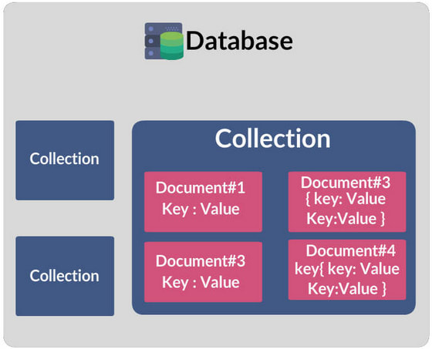
10.1 NoSQL Databases
Types(Categories) of NoSQL databases
3. Document Database:
Data modelling

Slide 21
10.1 NoSQL Databases
Types(Categories) of NoSQL databases
3. Document Database:
Features
Scalability: For more complex objects.
Data model: Collection of documents.
  Similar to JSON and XML.
Implements ACID transactions and adapt RDBMS characteristics.
  Allows indexing of documents based on its primary identifier and properties.
  Supports Query transactions (to an extent).
Design pattern allows retrieving info in a single operation.
Avoids performing joins within the application.

Slide 22
10.1 NoSQL Databases
Types(Categories) of NoSQL databases
3. Document Database:
Limitations
Base info duplication across multiple documents
Complicates design resulting in inconsistency.
  Solution: Link multiple documents using document identifiers (resembles foreign key in RDBMS)

Slide 23
10.1 NoSQL Databases
Types(Categories) of NoSQL databases
3. Document Database:
Real life examples
Shutterfly is a popular internet-based photo sharing and personal publishing company that manages a store of more than 6 billion images with a transaction rate of up to 10,000 operations per second.
eBay has a number of projects running on MongoDB for search suggestions, metadata storage, cloud management and merchandizing categorization.

Slide 24
10.1 NoSQL Databases
Types(Categories) of NoSQL databases
3. Document Database:
MongoDB
CouchDB

Slide 25
10.1 NoSQL Databases
Types(Categories) of NoSQL databases
4. Graph Database:
Graph Based Data Model in NoSQL is a type of Data Model which tries to focus on building the relationship between data elements.
Graphs are basically structures that depict connections between two or more objects in some data.
This pattern is very commonly used in social networks where there are a large number of entities and each entity has one or many characteristics which are connected by edges.

Slide 26
10.1 NoSQL Databases
Types(Categories) of NoSQL databases
4. Graph Database:
Parts of a graph
Nodes - representation of entities.
Properties - Information about nodes.
  Can be indexed.
Edges - Relationships between nodes.
  Can be indexed.
  Unidirectional or bidirectional, no limit of edges.

Slide 27
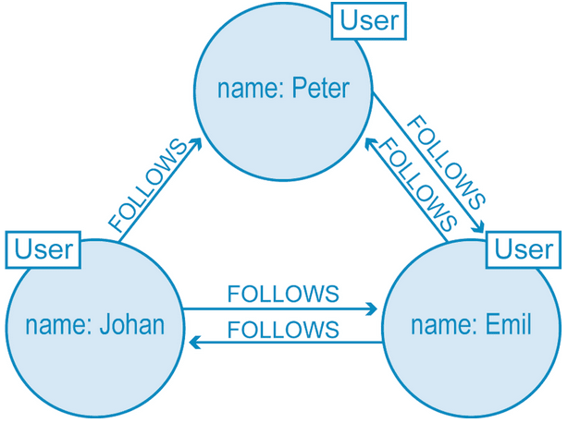
10.1 NoSQL Databases
Types(Categories) of NoSQL databases
4. Graph Database:

Slide 28
10.1 NoSQL Databases
Types(Categories) of NoSQL databases
4. Graph Database:
Features
Scales to the complexity of data.
Focus on interconnectivity.
Many query languages.

Slide 29
10.1 NoSQL Databases
Types(Categories) of NoSQL databases
4. Graph Database:
Limitations
Lack of high performance concurrency: In many cases, Graph Databases provide multiple reader and single writer type of transactions, which hinders their concurrency and performance as a consequence, somewhat limiting the threaded parallelism.
Lack of standard languages: The lack of a well established and standard declarative language is being a problem nowadays. Neo4j is proposing Cypher and Oracle is working on a language.
Lack of parallelism: One important issue is the fact that partitioning a graph is a problem. Thus, most do not provide shared nothing parallel queries on very large graphs. Thus, allowing for parallelism is intrinsically a problem.

Slide 30
10.1 NoSQL Databases
Types(Categories) of NoSQL databases
4. Graph Database:
Real life examples
Graph Store is used to model all kind of different scenarios such as:
Construction of a space rocket.
Transportation system (roads and trains).
Supply-chain and Logistics.
Medical history.
Fraud Detection.
Network and IT Operations.

Slide 31
10.1 NoSQL Databases
Types(Categories) of NoSQL databases
4. Graph Database:
Neo4J
Giraph.

Slide 32
10.1 NoSQL Databases
The CAP Theorem
It is very important to understand the limitations of NoSQL database. NoSQL can not provide consistency and high availability together. This was first expressed by Eric Brewer in CAP Theorem.
CAP theorem or Eric Brewers theorem states that we can only achieve at most two out of three guarantees for a database: Consistency, Availability and Partition Tolerance.

Slide 33
10.1 NoSQL Databases
The CAP Theorem
Consistency: Every read receives the most recent write or an error.
Availability: Every request receives a (non-error) response – without the guarantee that it contains the most recent write.
Partition tolerance: Even if there is a network outage in the data center and some of the computers are unreachable, still the system continues to perform.

Slide 34
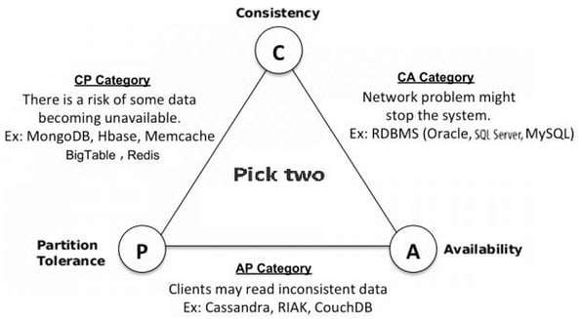
10.1 NoSQL Databases
The CAP Theorem
No system can provide more than 2 guarantees. In the case of a distributed systems, the partitioning of the network is a must, so the trade-off is always between consistency and availability.

Slide 35
Assignment
Advantages and Disadvantages of NoSQL
NoSQL vs SQL

Slide 36
10.2 Object Oriented Database and ORM
ODBMS stands for Object-Oriented Database Management System, which is a type of database management system that is designed to store and manage object-oriented data.
Object-oriented data is data that is represented using objects, which encapsulate data and behavior into a single entity.
Object oriented data model is based upon real world situations.
All these object have multiple relationships between them.

Slide 37
10.2 Object Oriented Database and ORM
It maintains correspondence between real world and database objects without loosing integrity and identity.
Object has state and behavior
Entity is represented as a class.
Instances of the class are objects.
Within an object , the class attributes takes specific values.

Slide 38
10.2 Object Oriented Database and ORM
Elements of object oriented model
Object
Attributes
Methods
Class

Slide 39
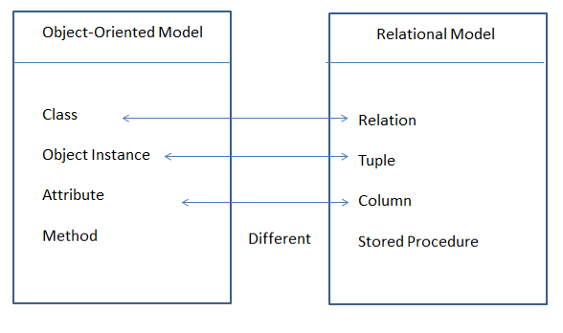
10.2 Object Oriented Database and ORM
Object v/s Relational Model

Slide 40
10.2 Object Oriented Database and ORM
Feature of object oriented Database
Object-Oriented Data Model: OODBs use an object-oriented data model to represent data as objects, which consist of attributes and methods.
Encapsulation: OODBs support encapsulation, which means that an object's data and methods are bundled together, providing data security and integrity.
Inheritance: OODBs allow objects to inherit attributes and methods from other objects, enabling the creation of hierarchical relationships and code reuse.

Slide 41
10.2 Object Oriented Database and ORM
Feature of object oriented Database
Polymorphism: OODBs support polymorphism, allowing objects to be treated as instances of their parent class, enabling flexibility and extensibility.
Complex Data Types: OODBs support complex data types, such as arrays, lists, and sets, providing flexibility in data representation.
Query Language: OODBs provide a query language that allows users to retrieve and manipulate objects using a language tailored for object-oriented data.

Slide 42
10.2 Object Oriented Database and ORM
Object Relational Mapping (ORM) is a technique used in creating a "bridge" between object-oriented programs and, in most cases, relational databases.
The idea of ORM is based on abstraction. The ORM mechanism makes it possible to address, access and manipulate objects without having to consider how those objects relate to their data sources.

Slide 43
10.2 Object Oriented Database and ORM
ORM is a programming technique for converting data between incompatible type systems into object oriented programming language.
This creates a virtual object database , which can be used from within the programming language.
It is necessary because objects are almost non-scales values while the DBMS can only store and manipulate scalar values organized within tables.
ORM convert object values into group of singular values for storages in the database.

Slide 44
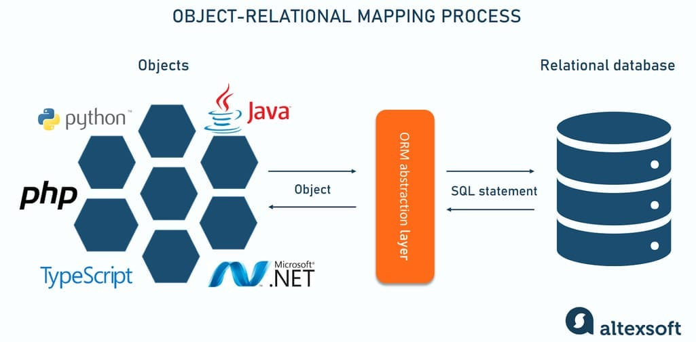
10.2 Object Oriented Database and ORM

Slide 45
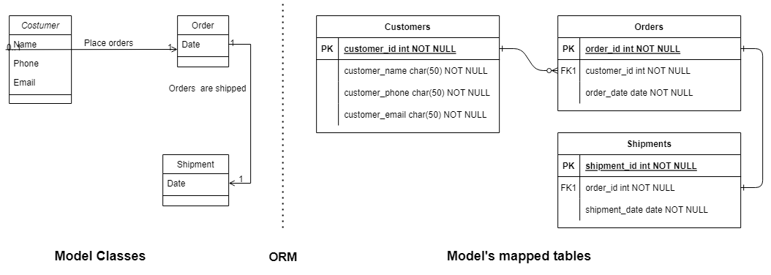
10.2 Object Oriented Database and ORM

Slide 46
10.2 Object Oriented Database and ORM
Here's an example of SQL code that retrieves information about a particular user from a database:
SELECT id, name, email, country, phone_number FROM users WHERE id = 20;
On the other hand, an ORM tool can do the same query as above with simpler methods. That is:
users.GetById(20);
So the code above does the same as the SQL query. Note that every ORM tool is built differently so the methods are never the same, but the general purpose is similar.

Slide 47
10.2 Object Oriented Database and ORM
Popular ORM Tools for Java
  Hibernate, Apache OpenJPA, EclipseLink
Popular ORM Tools for Python
  Django, Web2py, SQLObject
Popular ORM Tools for PHP
  Laravel, CakePHP, Doctrine
Popular ORM Tools for .NET
  Entity Framework, Nhibernate, Dapper

Slide 48
Assignment
Advantages and Disadvantages of ODBMS
Advantages and Disadvantages of ORM
ODBMS vs RDBMS

Slide 49
11.3 Distributed Database
The database is stored on several computers known as sites.
Each site is largely coupled.
There is no any stored physical component.
Communication between sites is done with network.
Local transaction access data only from site where it was initiated.
Global transaction access data from different sites.

Slide 50
11.3.1 Heterogeneous Database
Each site uses different schema.
Difficulty in query and transaction processing.
Provide limited facility for cooperation
Also, a particular site might be completely unaware of the other sites.
Different computers may use a different operating system, different database application.

Slide 51
11.3.2 Homogeneous Database
All sites have identical dbms software
The operating system, database management system and the data structures used – all are same at all sites.
Agree to cooperate in processing user requests.
Each site surrender part of anatomy as a right to change schema
It appears as a single system for users.

Slide 52
11.3.3 Data replication
Approach to store distributed data in which system contains multiple copies of data in different sites.
Full replication indicates storing at all sites,
Fully redundant indicates each site having entire copy of database.
It ensures availability ,parallelism and reduced data transfer
Update cost is high
Difficult for concurrency control

Slide 53
11.3.4 Data fragmentation
Approach to store distributed in which relation r is divided.
Fragments with sufficient information to reconstruct r
Each schema should have common candidate key to ensure lossless join.
In horizontal each tuple of r is assigned to one or more fragments.
It allows parallel processing and easy access.
In vertical schema is split into several smaller schemes.
It allows parallel processing on relation.

Slide 54
Data Warehouse
Data warehouse is a single ,complete and consistent data store obtained from a variety of sources made available to end users in the understandable form and used as a business context.
It is subject oriented, integrated , time-variant and non-volatile collection of data to support decision making process.

Slide 55
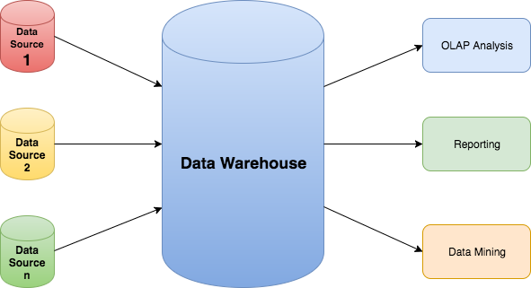
Data Warehouse

Slide 56
Online Analytical Processing (OLAP)
OLAP systems have the capability to analyze database information of multiple systems at the current time.
The primary goal of OLAP Service is data analysis and not data processing.
Online Analytical Processing (OLAP) consists of a type of software tool that is used for data analysis for business decisions.
OLAP provides an environment to get insights from the database retrieved from multiple database systems at one time.

Slide 57
Online Analytical Processing (OLAP)
OLAP Examples
Any type of Data Warehouse System is an OLAP system.
The uses of the OLAP System are described below.
  Spotify analyzed songs by users to come up with a personalized homepage of their songs and playlist.
  Netflix movie recommendation system.

Slide 58
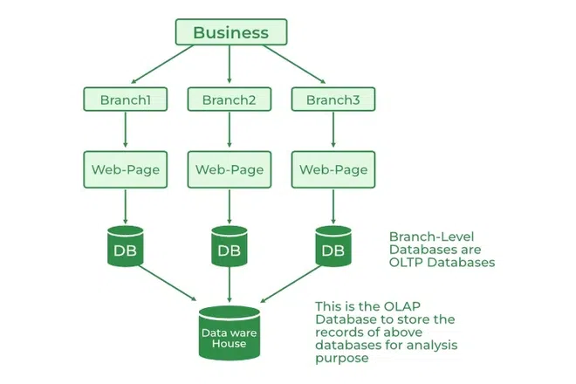
Online Analytical Processing (OLAP)

Slide 59
Online Transaction Processing (OLTP)
OLTP has the work to administer day-to-day transactions in any organization.
The main goal of OLTP is data processing not data analysis.
Online transaction processing provides transaction-oriented applications in a 3-tier architecture.
OLTP administers the day-to-day transactions of an organization.

Slide 60
Online Transaction Processing (OLTP)
OLTP Examples
An example considered for OLTP System is ATM Center a person who authenticates first will receive the amount first and the condition is that the amount to be withdrawn must be present in the ATM.
The uses of the OLTP System are described below.
  ATM center is an OLTP application.
  OLTP handles the ACID properties during data transactions via the application.
  It’s also used for Online banking, Online airline ticket booking, sending a text message, add a book to the shopping cart.

Slide 61
Assignment
Advantages and Disadvantages of Distributed Database
Distributed v/s Parallel Processing
Advantages and disadvantages of data warehouse
OLAP v/s OLTP

Slide 62
10.4 Distributed Ledged Technology: Blockchain
Distributed Ledger Technology (DLT) is centered around an encoded and distributed database where records regarding transactions are stored.
A distributed ledger is a database that is spread across various computers, nodes, institutions, or countries accessible by multiple people around the globe.

Slide 63
10.4 Distributed Ledged Technology: Blockchain
DLT allows real-time sharing of data with transparency which gives trust that data in the ledger is up to date and legitimate.
Distributed Ledger Technology eliminates the single point of failure which prevents data in the ledger from being manipulations and errors.
In DLT, there is no need for a central authority to validate transactions here different consensus mechanisms are used to validate transactions which eventually makes this process very fast and real-time.
Similarly, DLT can reduce the cost of transactions because of this process.

Slide 64
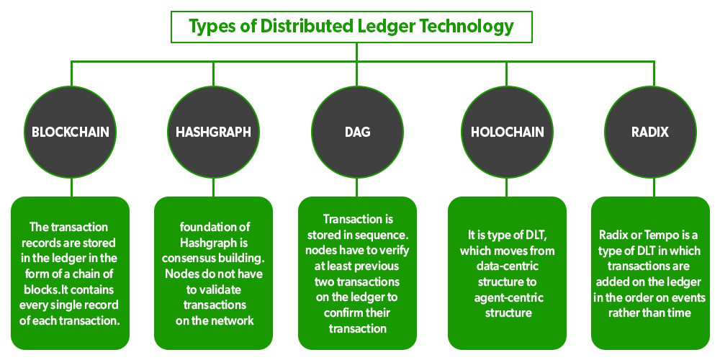
10.4 Distributed Ledged Technology: Blockchain

Slide 65
10.4 Distributed Ledged Technology: Blockchain
A blockchain is a decentralized ledger that records all transactions that are visible on a public network. a blockchain’s architecture allows these transactions to be autonomous and immutable while using cryptography and a decentralized network design for security.
Every transaction is permanently recorded to the blockchain and cannot be altered in any way.
Blockchain was invented by Satoshi Nakamoto.

Slide 66
10.4 Distributed Ledged Technology: Blockchain
A blockchain uses several technologies like digital signatures, distributed networks, and encryption/ decryption methods including distributed ledger technology to enable blockchain applications.
Blockchain is one of the types of DLT in which transactions are recorded with an unchangeable cryptographic signature called a hash. That is why distributed ledgers are often called blockchains.

Slide 67
10.4 Distributed Ledged Technology: Blockchain
Blockchain is a combination of three leading technologies:
Cryptographic keys
A peer-to-peer network containing a shared ledger
A means of computing, to store the transactions and records of the network

Slide 68
10.4 Distributed Ledged Technology: Blockchain
Key elements of a blockchain
1. Distributed ledger technology
All network participants have access to the distributed ledger and its immutable record of transactions. With this shared ledger, transactions are recorded only once, eliminating the duplication of effort that’s typical of traditional business networks.

Slide 69
10.4 Distributed Ledged Technology: Blockchain
Key elements of a blockchain
2. Immutable records
No participant can change or tamper with a transaction after it’s been recorded to the shared ledger. If a transaction record includes an error, a new transaction must be added to reverse the error, and both transactions are then visible.

Slide 70
10.4 Distributed Ledged Technology: Blockchain
Key elements of a blockchain
3. Smart contracts
To speed transactions, a set of rules — called a smart contract — is stored on the blockchain and executed automatically. A smart contract can define conditions for corporate bond transfers, include terms for travel insurance to be paid and much more.

Slide 71
10.4 Distributed Ledged Technology: Blockchain
How blockchain works
As each transaction occurs, it is recorded as a “block” of data
Those transactions show the movement of an asset that can be tangible (a product) or intangible (intellectual). The data block can record the information of your choice: who, what, when, where, how much and even the condition — such as the temperature of a food shipment.

Slide 72
10.4 Distributed Ledged Technology: Blockchain
How blockchain works
Each block is connected to the ones before and after it
These blocks form a chain of data as an asset moves from place to place or ownership changes hands. The blocks confirm the exact time and sequence of transactions, and the blocks link securely together to prevent any block from being altered or a block being inserted between two existing blocks.

Slide 73
10.4 Distributed Ledged Technology: Blockchain
How blockchain works
Transactions are blocked together in an irreversible chain: a blockchain
Each additional block strengthens the verification of the previous block and hence the entire blockchain. This renders the blockchain tamper-evident, delivering the key strength of immutability. This removes the possibility of tampering by a malicious actor — and builds a ledger of transactions you and other network members can trust.

Slide 74
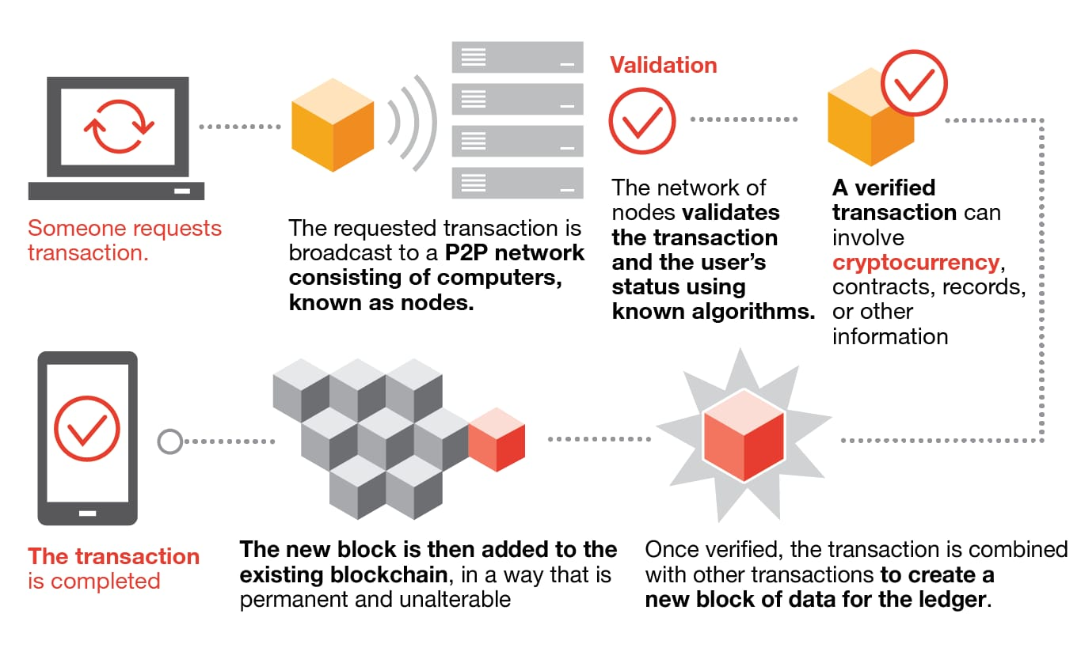
10.4 Distributed Ledged Technology: Blockchain
How blockchain works

Slide 75
10.4 Distributed Ledged Technology: Blockchain
Cryptocurrency
Cryptocurrency, sometimes called crypto-currency or crypto, is any form of currency that exists digitally or virtually and uses cryptography to secure transactions.
Cryptocurrencies don't have a central issuing or regulating authority, instead using a decentralized system to record transactions and issue new units.

Slide 76
10.4 Distributed Ledged Technology: Blockchain
Cryptocurrency
Cryptocurrency is a digital payment system that doesn't rely on banks to verify transactions.
It’s a peer-to-peer system that can enable anyone anywhere to send and receive payments.
When you transfer cryptocurrency funds, the transactions are recorded in a public ledger. Cryptocurrency is stored in digital wallets.

Slide 77
10.4 Distributed Ledged Technology: Blockchain
How does cryptocurrency work?
Units of cryptocurrency are created through a process called mining, which involves using computer power to solve complicated mathematical problems that generate coins.
Users can also buy the currencies from brokers, then store and spend them using cryptographic wallets.
If you own cryptocurrency, you don’t own anything tangible. What you own is a key that allows you to move a record or a unit of measure from one person to another without a trusted third party.

Slide 78
10.4 Distributed Ledged Technology: Blockchain
Cryptocurrency examples
1. Bitcoin:
Founded in 2009, Bitcoin was the first cryptocurrency and is still the most commonly traded. The currency was developed by Satoshi Nakamoto – widely believed to be a pseudonym for an individual or group of people whose precise identity remains unknown.
2. Ethereum:
Developed in 2015, Ethereum is a blockchain platform with its own cryptocurrency, called Ether (ETH) or Ethereum. It is the most popular cryptocurrency after Bitcoin.

Slide 79
10.4 Distributed Ledged Technology: Blockchain
Cryptocurrency examples
3. Litecoin:
This currency is most similar to bitcoin but has moved more quickly to develop new innovations, including faster payments and processes to allow more transactions.
4. Ripple:
Ripple is a distributed ledger system that was founded in 2012. Ripple can be used to track different kinds of transactions, not just cryptocurrency. The company behind it has worked with various banks and financial institutions.

Slide 80
10.4 Distributed Ledged Technology: Blockchain
Properties / Features of Blockchain
1. Immutable
Immutability means that the blockchain is a permanent and unalterable network. Once a transaction is recorded on the blockchain, it cannot be modified or deleted.
2. Distributed
All network participants have a copy of the ledger for complete transparency. A public ledger will provide complete information about all the participants on the network and transactions.

Slide 81
10.4 Distributed Ledged Technology: Blockchain
Properties / Features of Blockchain
3. Decentralized
Blockchain technology is a decentralized system, which means that there is no central authority controlling the network. Each and every node in the blockchain network will have the same copy of the ledger.
4. Secure
All the records in the blockchain are individually encrypted. Every information on the blockchain is hashed cryptographically which means that every piece of data has a unique identity on the network.

Slide 82
10.4 Distributed Ledged Technology: Blockchain
Properties / Features of Blockchain
5. Consensus
Every blockchain has a consensus to help the network to make quick and unbiased decisions. Consensus is a decision-making algorithm for the group of nodes active on the network to reach an agreement quickly and faster and for the smooth functioning of the system.
6. Unanimous
All the network participants agree to the validity of the records before they can be added to the network. When a node wants to add a block to the network then it must get majority voting otherwise the block cannot be added to the network.

Slide 83
10.4 Distributed Ledged Technology: Blockchain
Properties / Features of Blockchain
Smart Contracts
Transparency
Faster Settlement

Slide 84
This is the end of the lecture!
I hope you enjoyed it.
Thank You

